Slide 1
Packages && Docs
unique namespaces

Slide 2
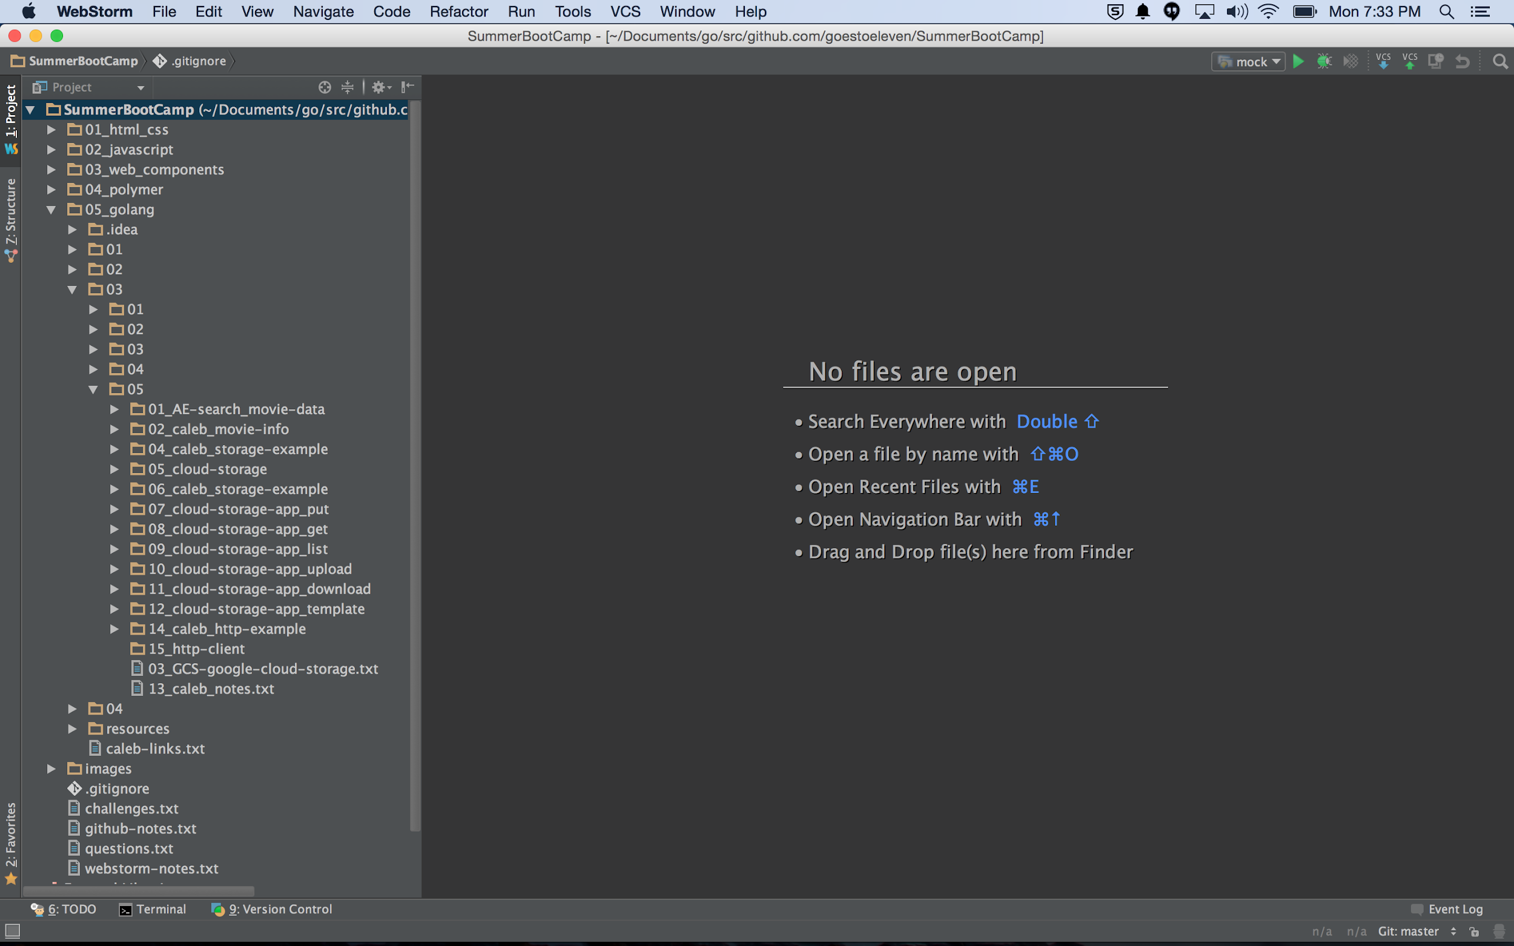
You can think of “packages” as just another name for “folders.”
Just as a folder can contain more folders and files, so too a package can contain more packages and files.
The unique name of a “package” is the path after the “src” folder - this will make more sense in a moment
I do it like this for sequentially storing code. This is good for teaching or storing code examples that build from step-to-step.

Slide 3
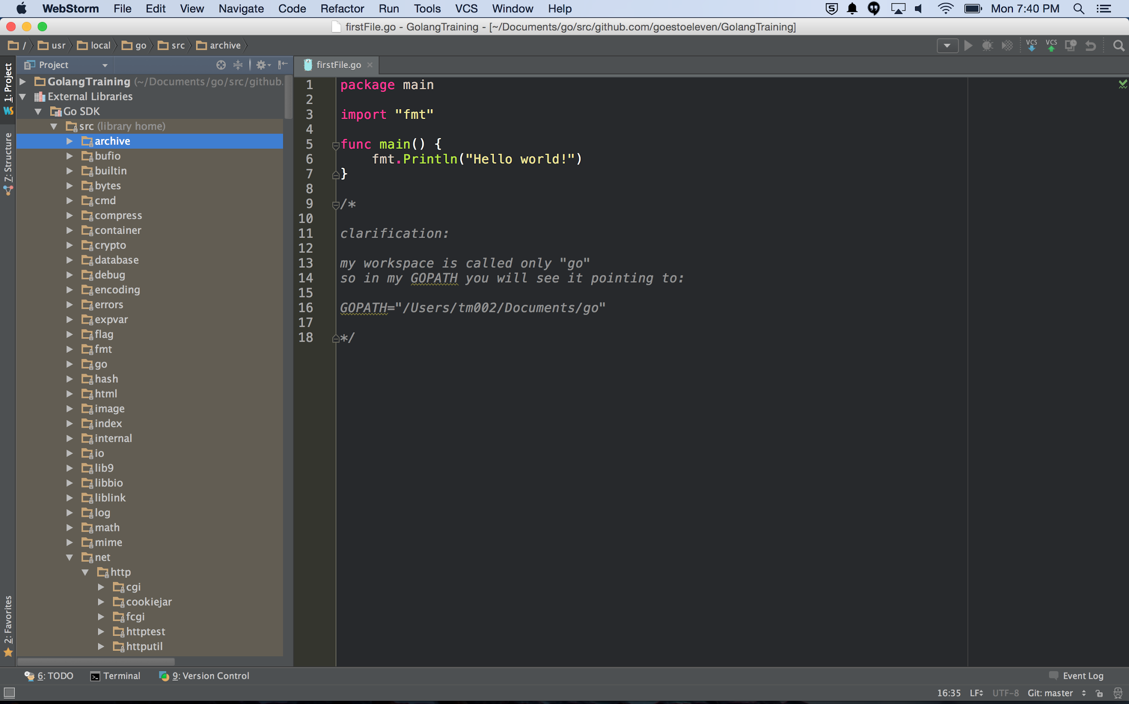
Look at the Go source code
(software development kit, aka, SDK)
to see how it is organized using packages.

Slide 4
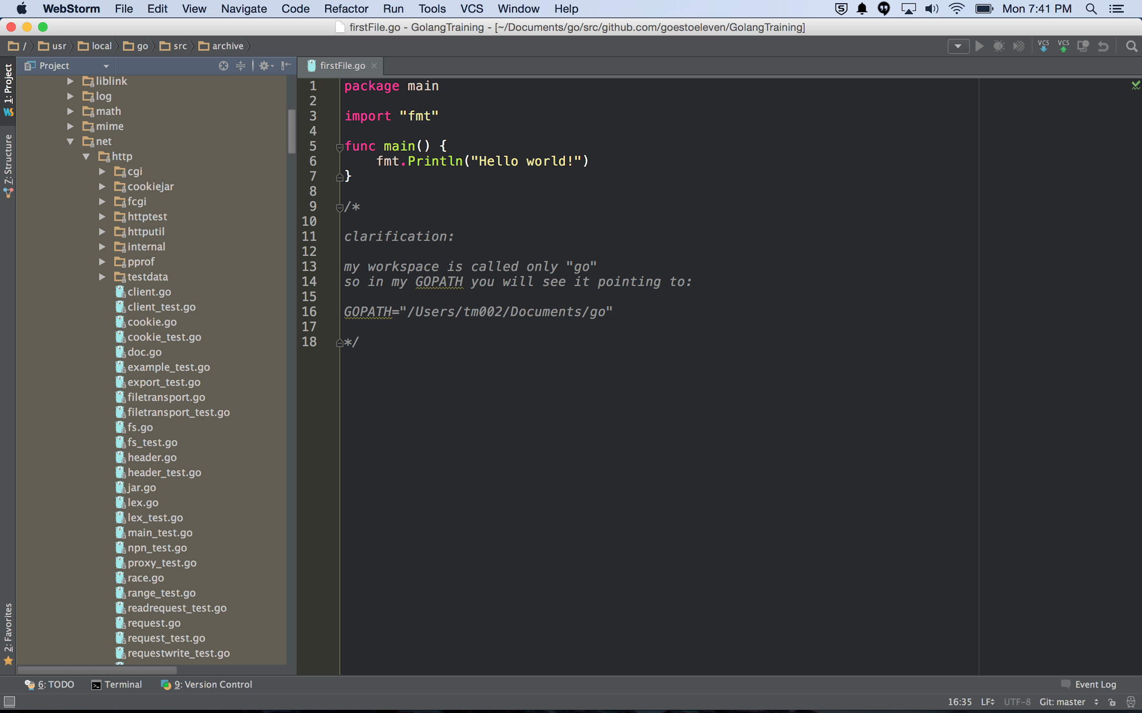
Here is more from the Go source code - see how it is organized using packages.
Remember, you can think of “packages” as just another name for “folders.”
Just as a folder can contain more folders and files, so too a package can contain more packages and files.
PACKAGES = FOLDERS

Slide 5
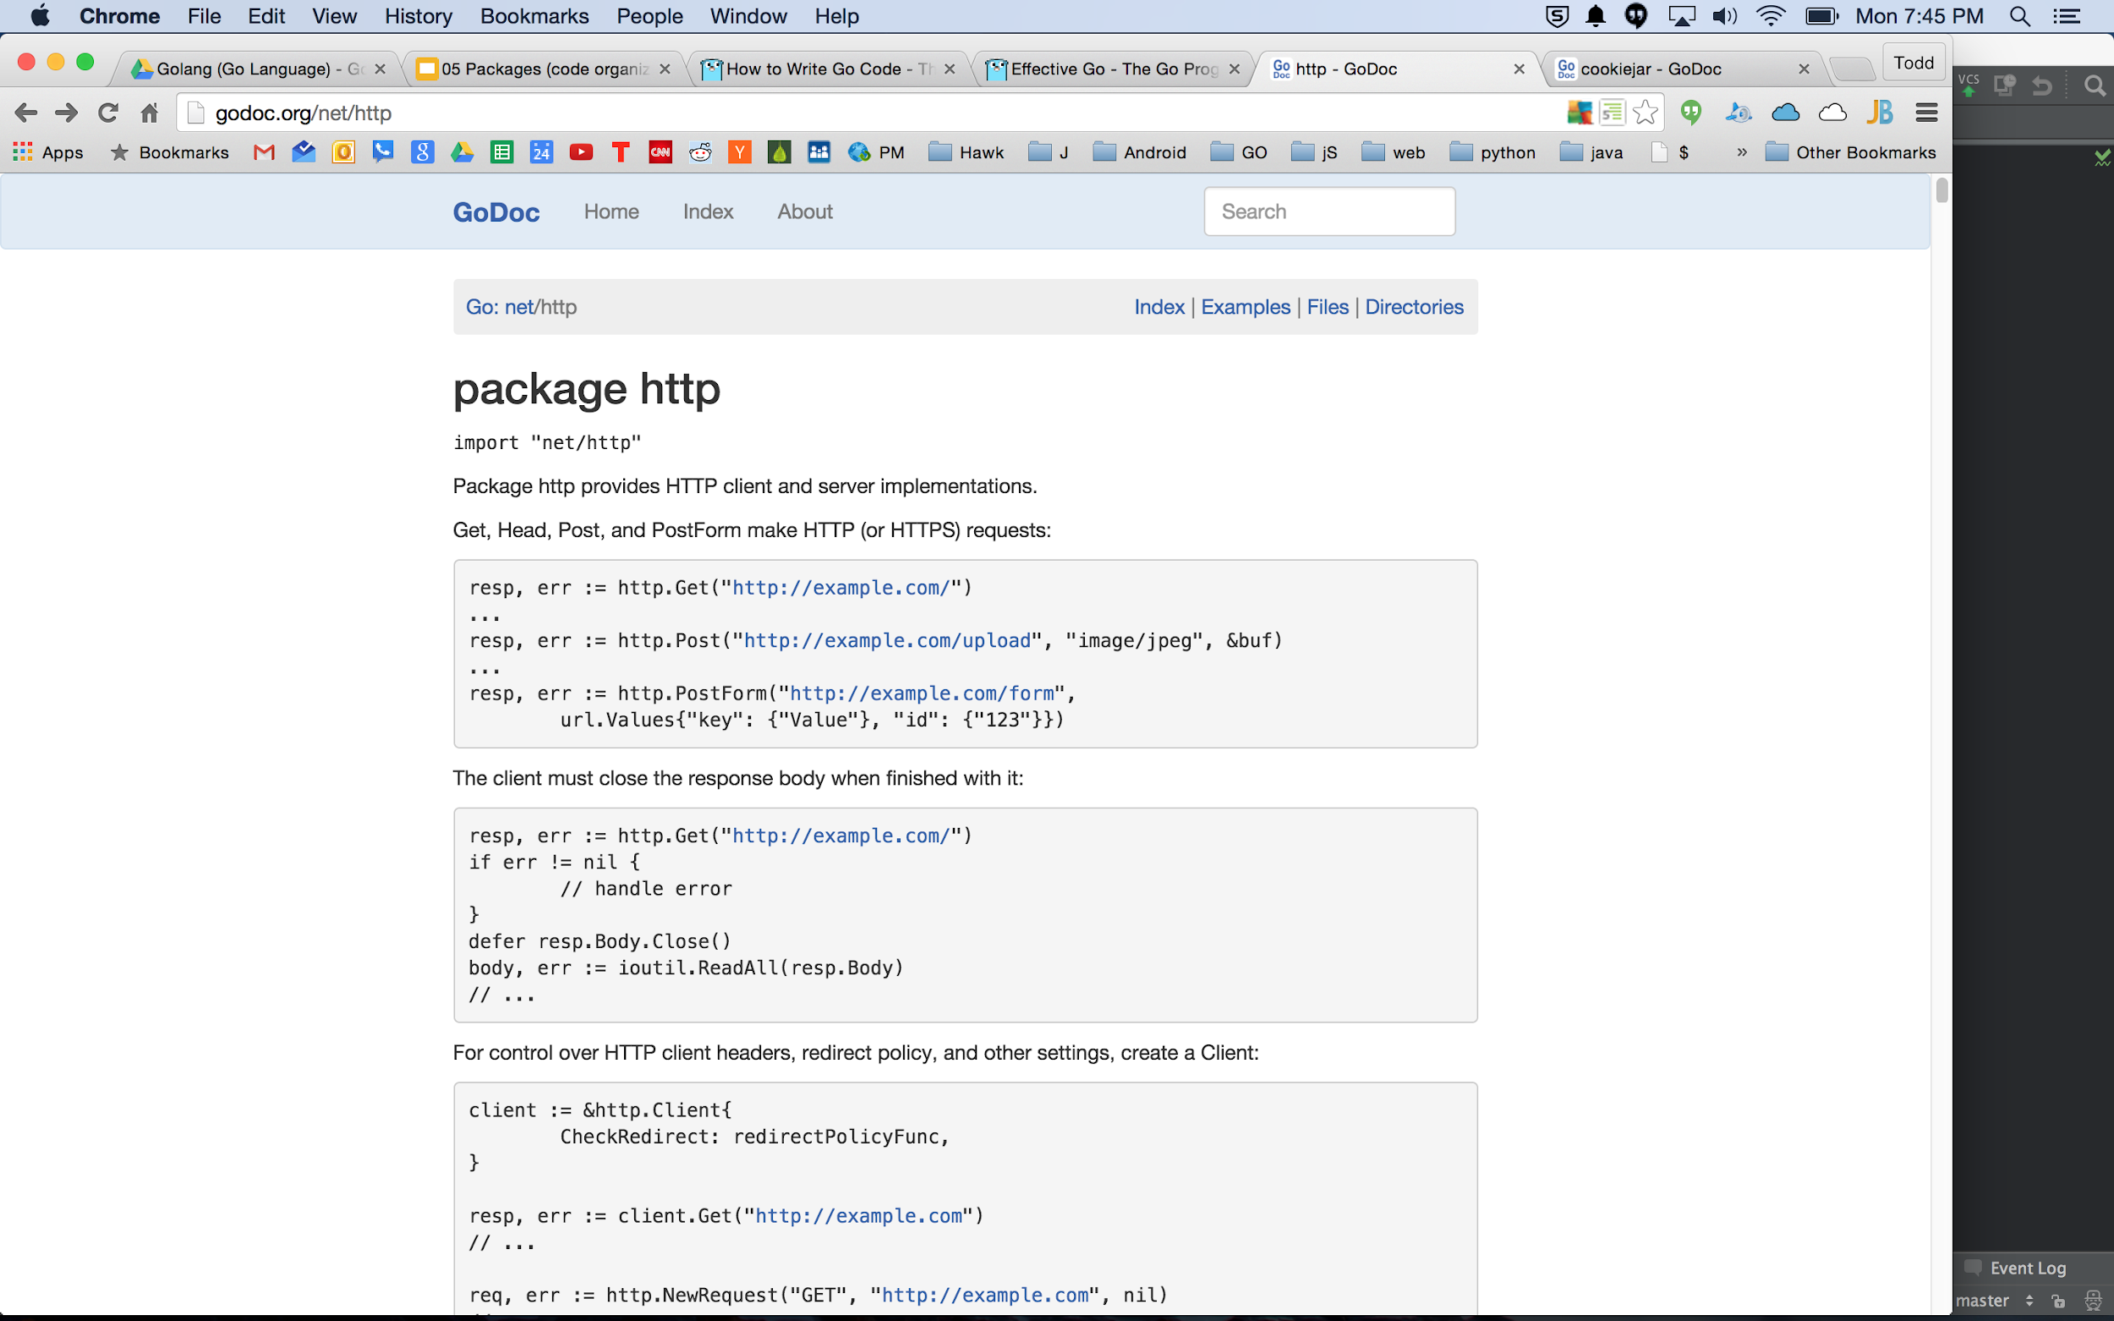
Godoc.org documents the go language.
Notice how the URL corresponds with the package being documented.

Slide 6
Godoc.org documents the go language.
Notice how the URL corresponds with the package being documented.

Slide 7
What is this package?
What would be the URL by which you would look it up at godoc.org?

Slide 8
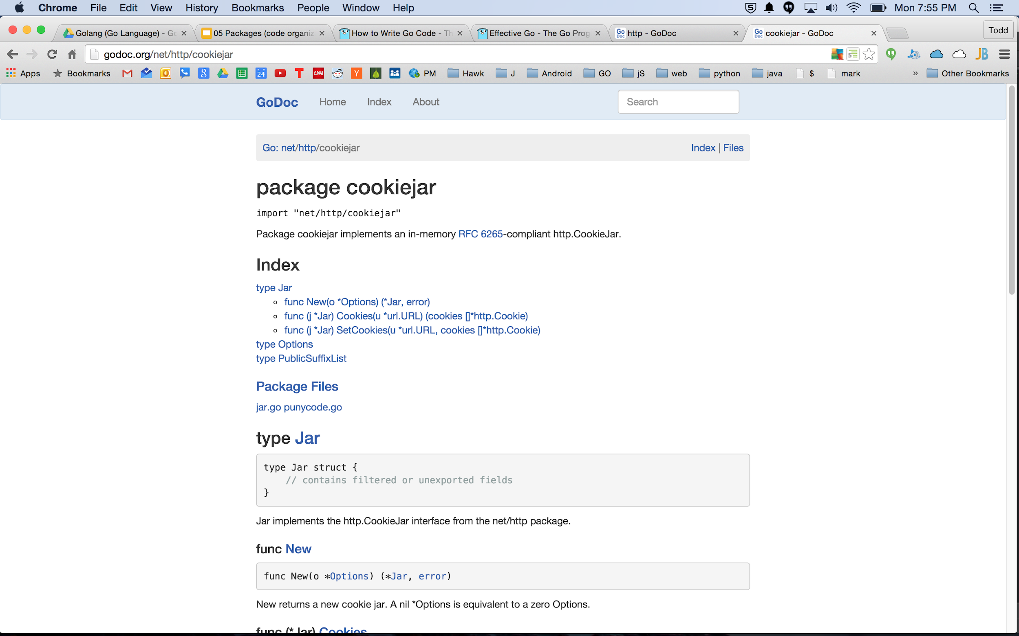
What is this package?
What would be the URL by which you would look it up at godoc.org?

Slide 9
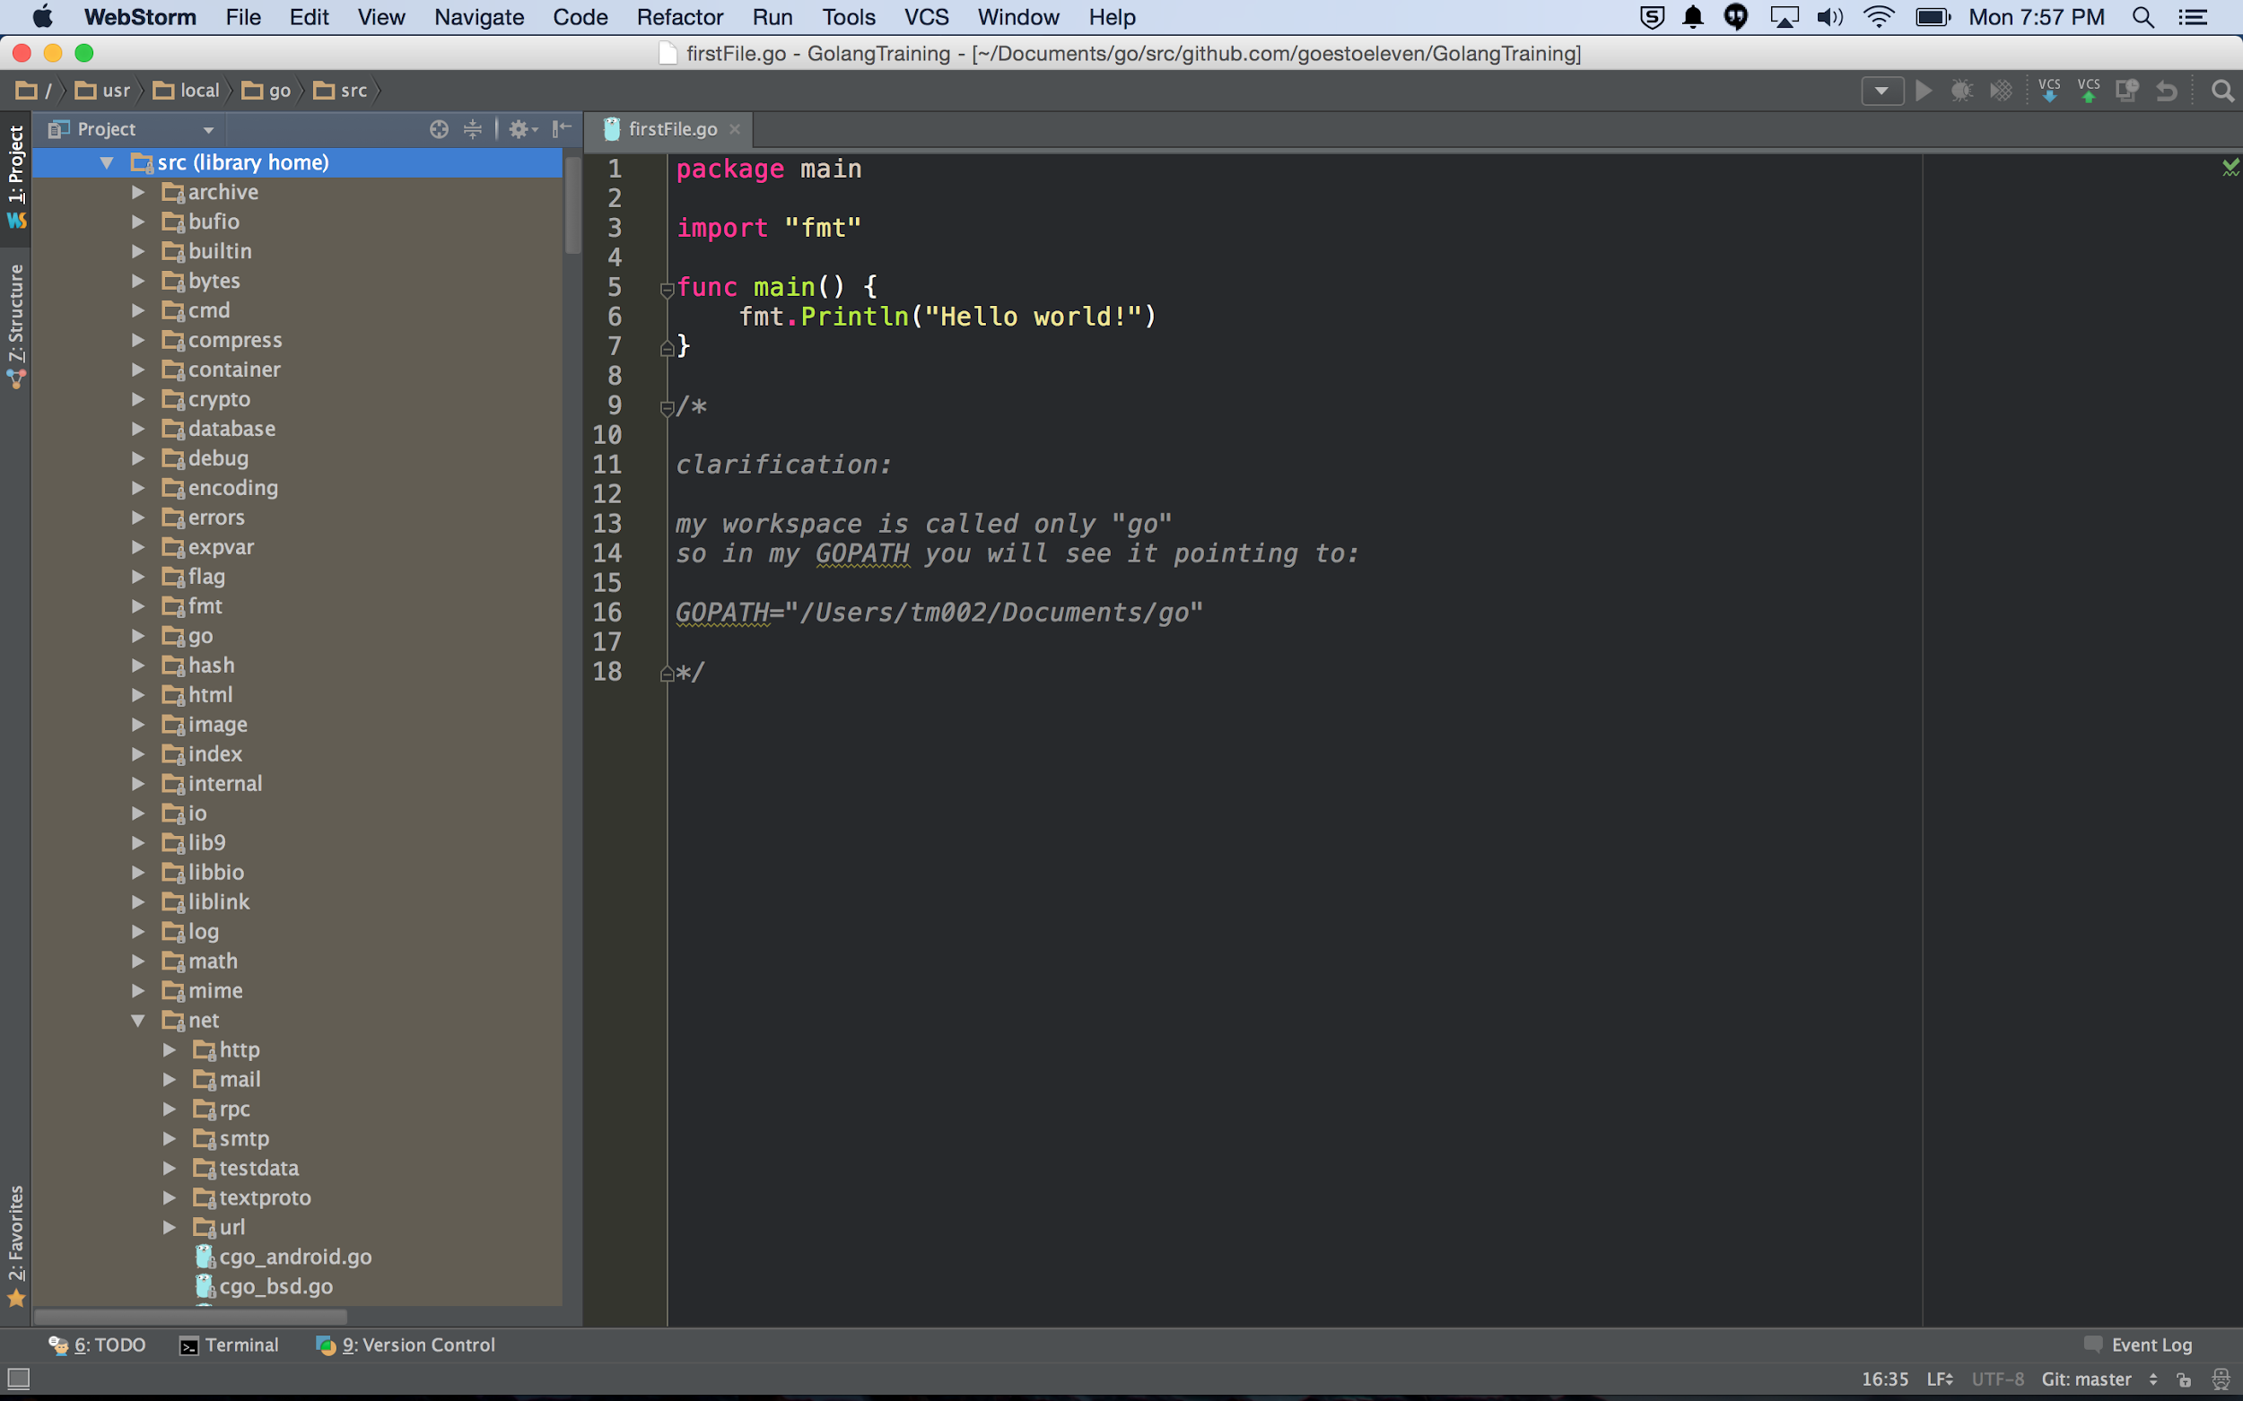
It’s inspiring to explore the Go source code and speculate as to what is possible ...

Slide 10
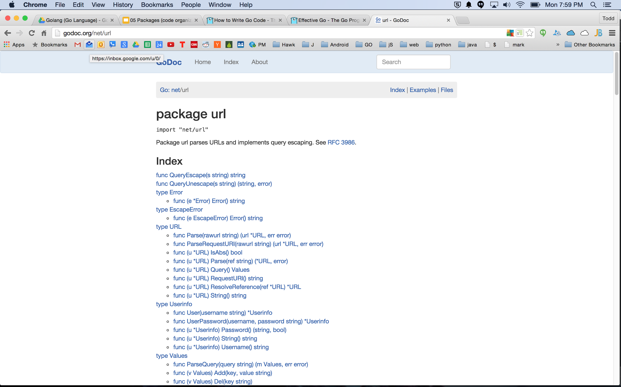
… and then go look at the docs to see what can be done.

Slide 11
The unique package name is determined by the path after the “src” folder.

Slide 12
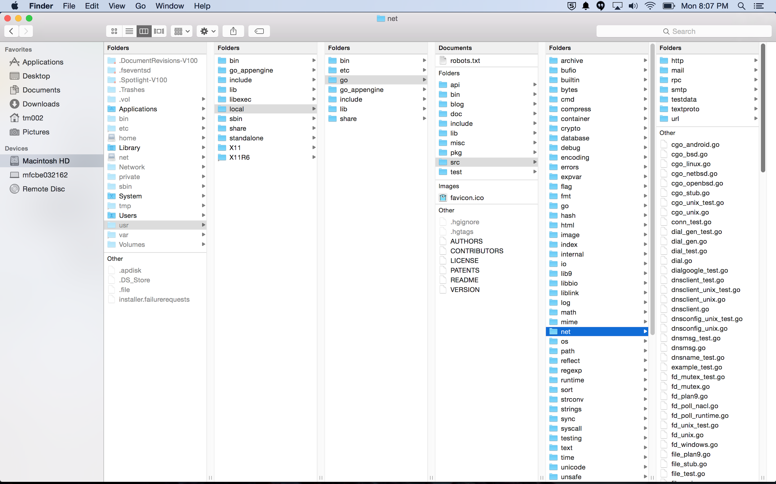
Here is the same source code in finder.
Same thing: the unique package name is the folder path after the “src” folder

Slide 13
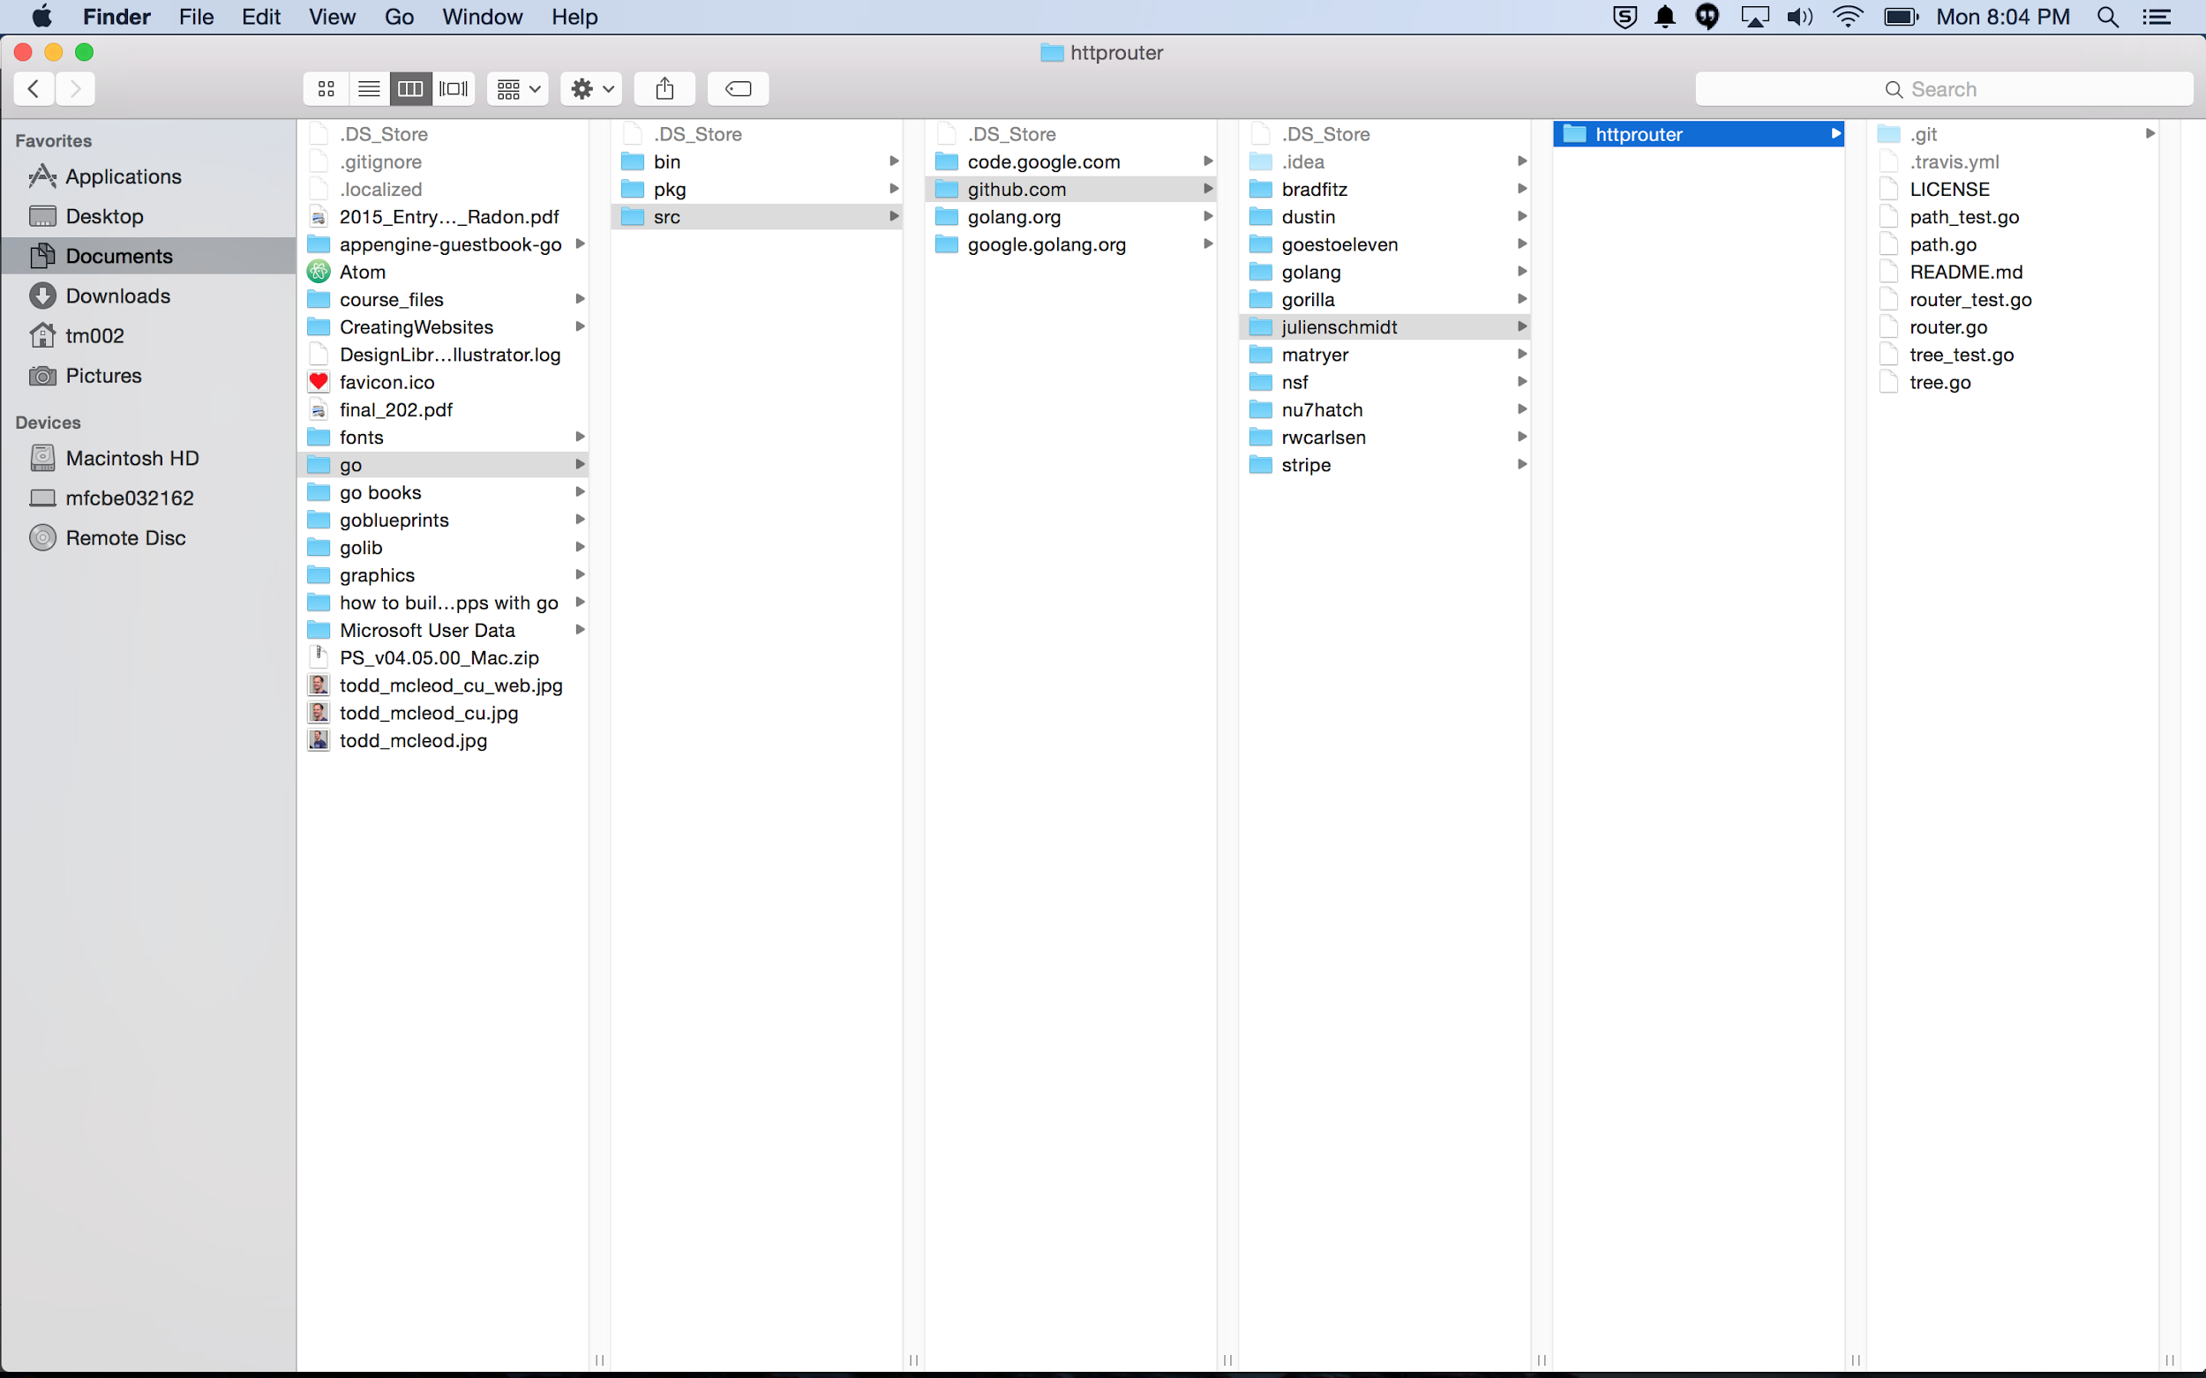
Here is some code from my workspace.
What is the name of this package?

Slide 14
Here is some code from my workspace.
What is the name of this package?
Everything after the “src” folder, remember?

Slide 15
Here is some code from my workspace.
What is the name of this package?
Everything after the “src” folder, remember?
This is Golang’s way of “name spacing”

Slide 16
namespace
In computing, a namespace is used to organize objects of various kinds, so that these objects may be referred to by name.
Examples include:
file systems are namespaces that assign names to files
programming languages organize variables and subroutines in namespaces
computer networks and distributed systems assign names to resources, such as computers, printers, websites, (remote) files, etc.
Namespaces are commonly structured as hierarchies to allow reuse of names in different contexts.
Example: human names. Jane Doe. Within the namespace of the Doe family, just "Jane" suffices to unambiguously designate this person, while within the "global" namespace of all people, the full name must be used.
In a similar way, hierarchical file systems organize files in directories. Each directory is a separate namespace, so that the directories may both contain a file "jane". In computer programming, namespaces are typically employed for the purpose of avoiding name collisions between multiple identifiers that share the same name.
source: wikipedia

Slide 17
Given this namespace / package name ...

Slide 18
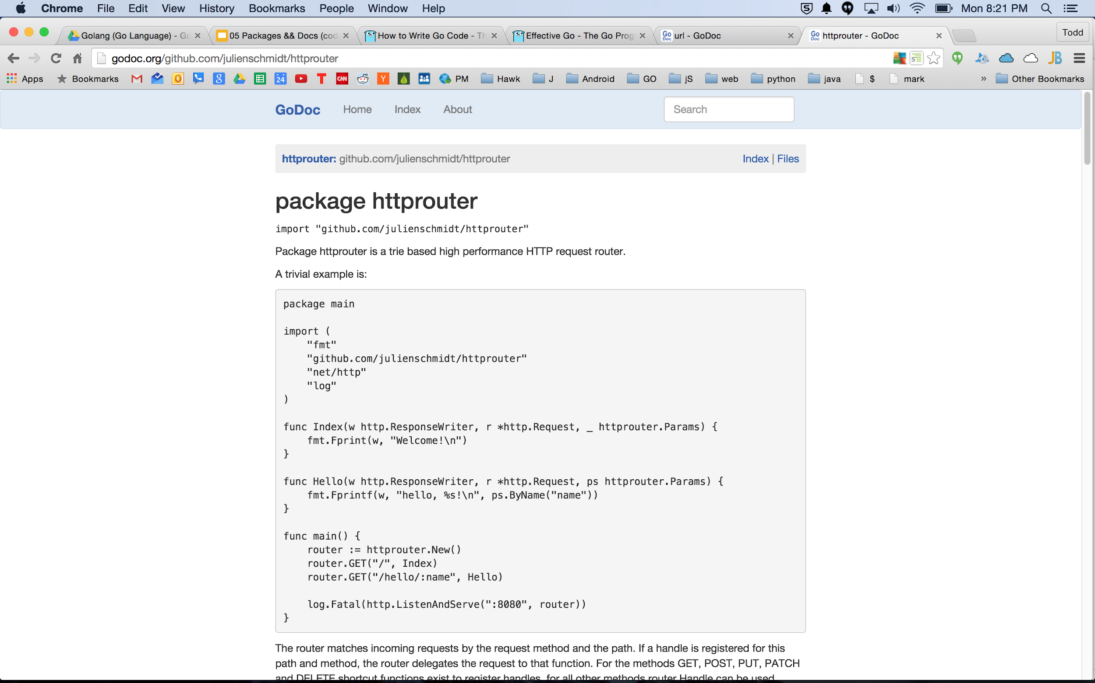
We can find documentation about that code on godoc.org
Check out the URL.
Notice the import statement that we would use to use the code in our code.

Slide 19
Remember how we organize our code?
Remember “go get”?
go get github.com/goestoeleven/golangtraining
It’s all connected.

Slide 20
documentation
godoc.org vs golang.org vs. godoc at terminal
I mainly use godoc.org as it includes the packages of others.

Slide 21
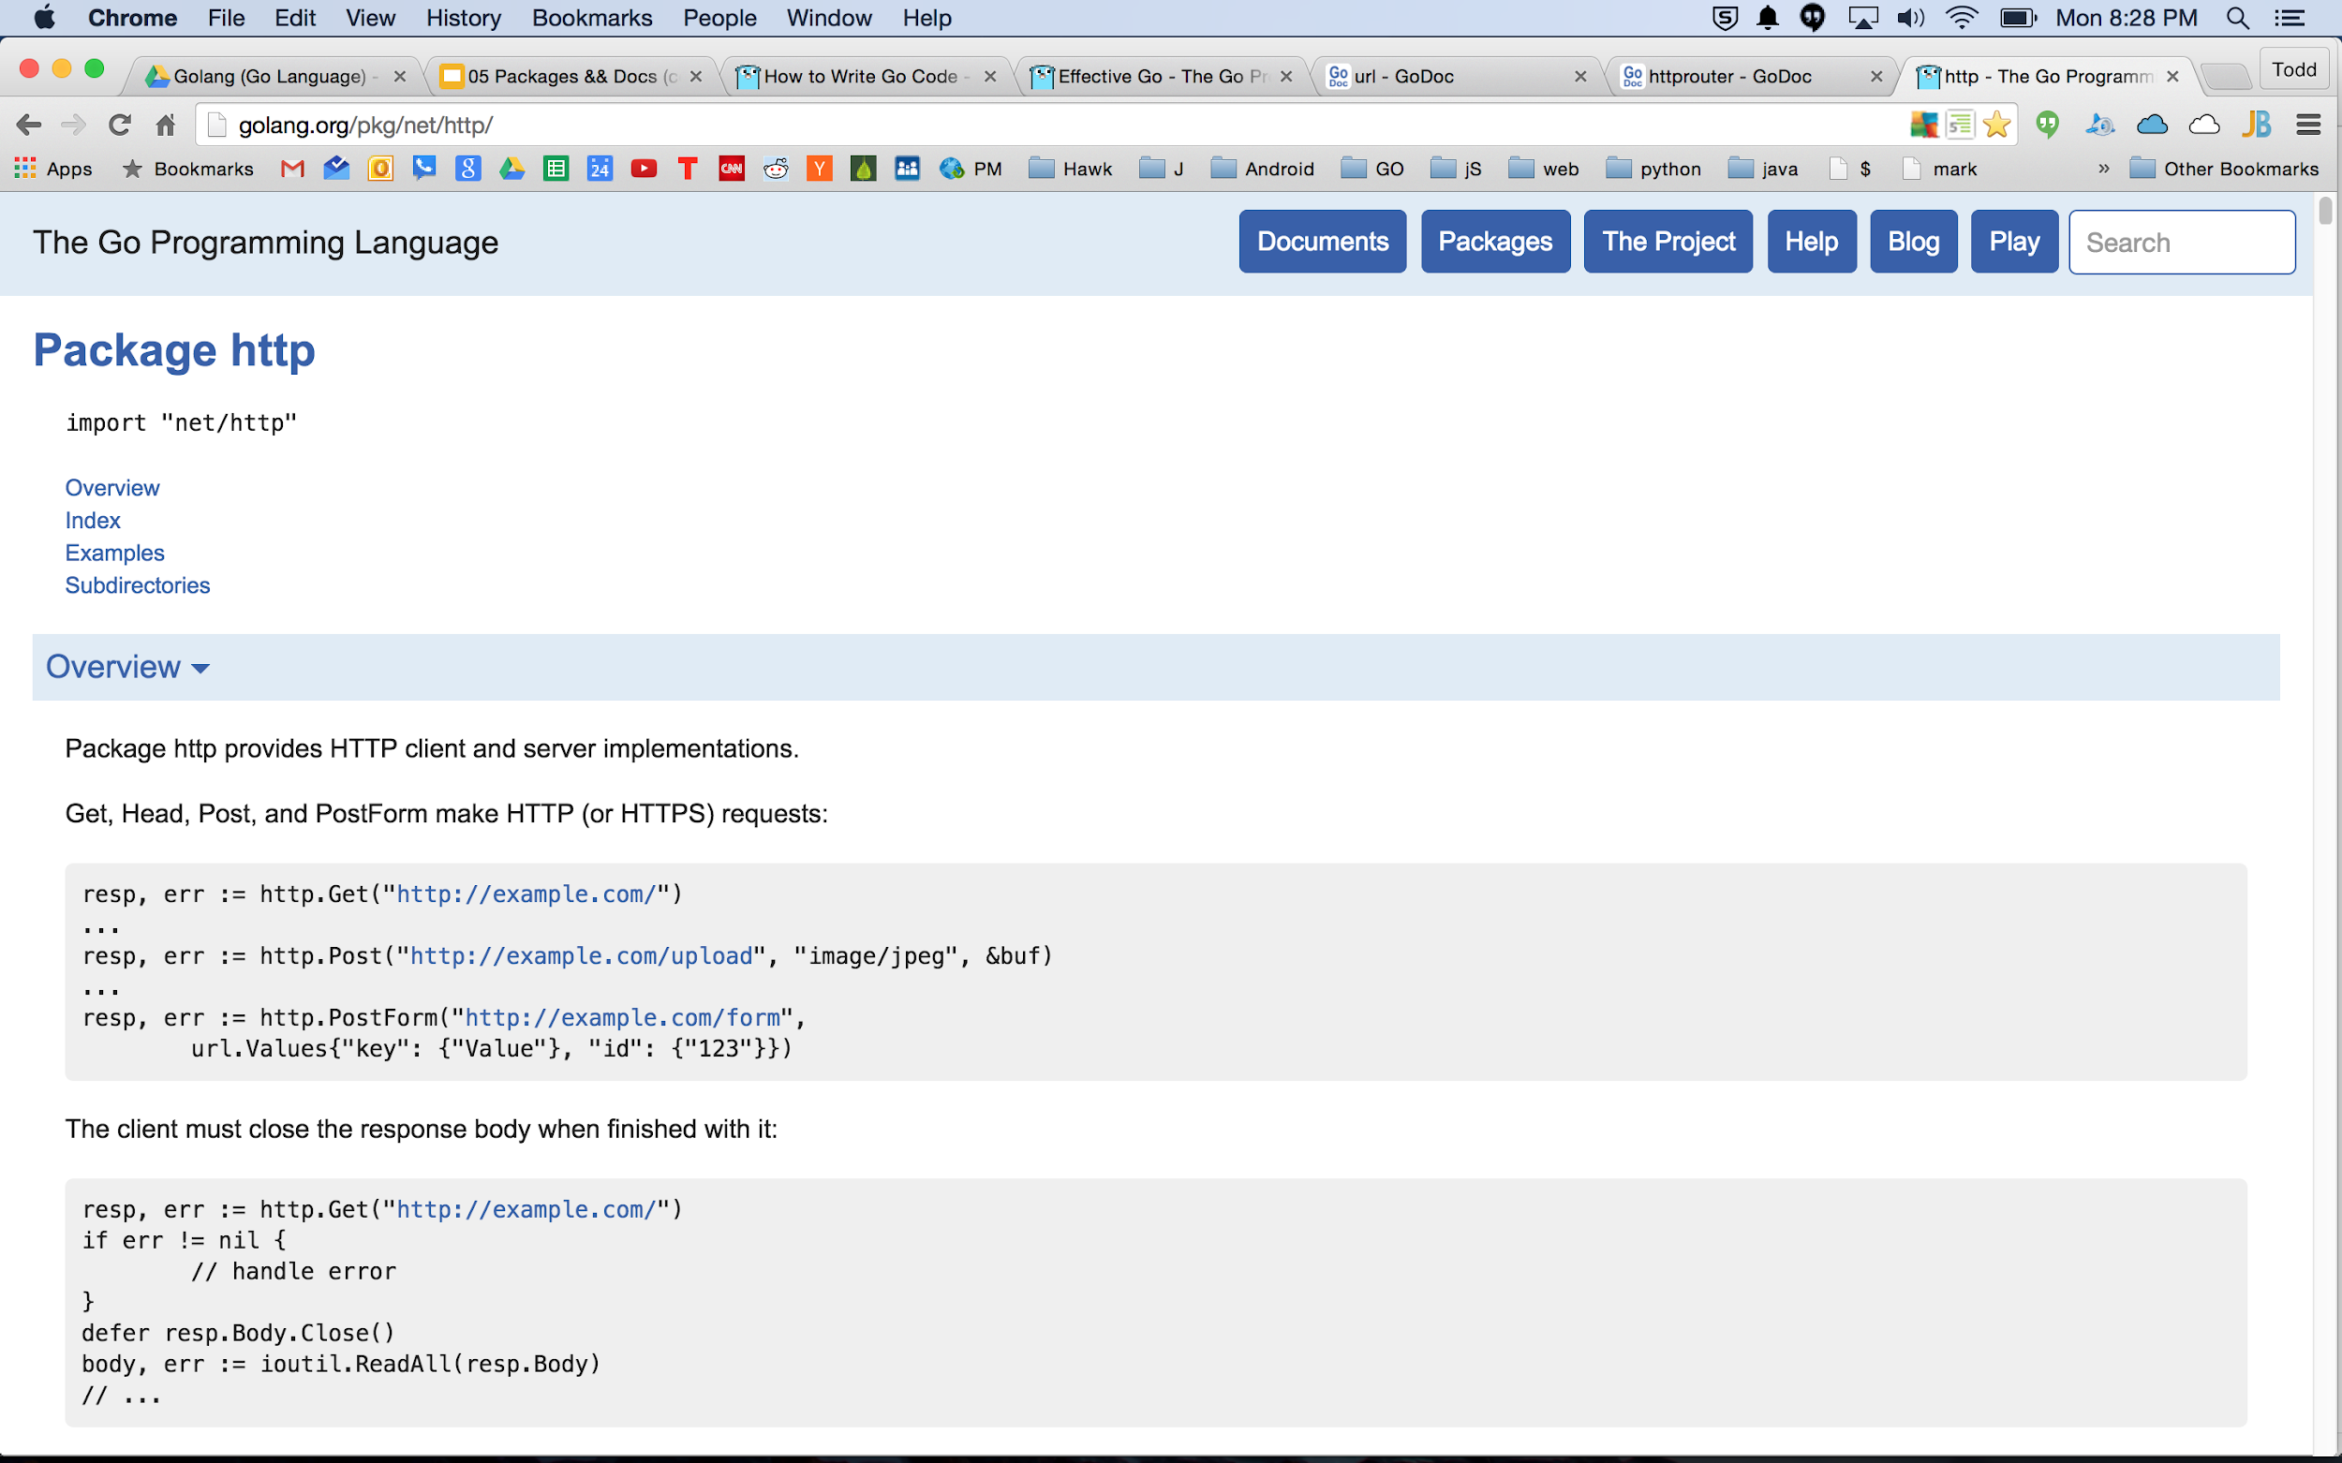
Go documentation can also be found at golang.org
Golang.org only has documentation of go source code
you won’t find “github.com/julienschmidt/httprouter” here
Godoc.org has documentation of all go packages, including go source code
you will find “github.com/julienschmidt/httprouter” here
I use godoc.org

Slide 22
package naming
https://golang.org/doc/code.html#PackageNames

Slide 23
package naming
https://golang.org/doc/effective_go.html#names

Slide 24
searching for packages / libraries
search godoc.org

Slide 25
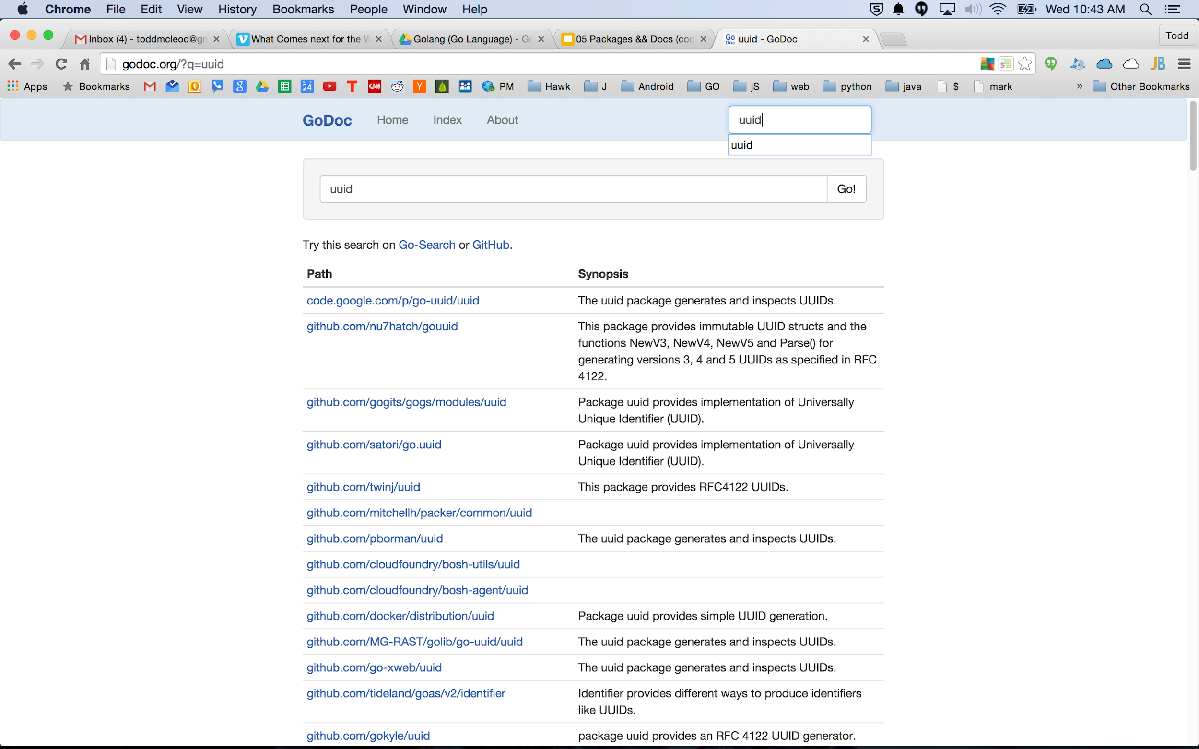

Slide 26
I use this one

Slide 27
Review
packages
packages = folders
SDK - software development kit
namespace
unique namespace of packages: everything after the “src” folder
documentation
godoc.org
golang.org
godoc at terminal
package names / paths
searching for packages

Slide 28
Review Review - You’ve learned a lot
golang is awesome
SHA1
go version
go env
go help
environment variables
GOPATH
GOROOT
workspace
bin
pkg
src
github.com
your_user_name
your_packages
your code
.bash_profile / .bashrc
GO IDE’s
webstorm
atom
func main()
packages
functions vs methods
parameters vs arguments
expressions vs statements
variable, constant, literal
go run
go build
go install
go get
go commands
Go, Github, & Webstorm
git
git log
.gitignore
Packages / Libraries
naming
namespace
documentation
godoc.org
golang.org
godoc at terminal

Slide 29
Review Questions

Slide 30
Namespacing
Define namespace.

Slide 31
go commands
List and define the go commands you have learned so far.
I know this is repetitive, but repetition helps us learn.

Slide 32
godoc.org
Find a package for gorilla sessions on godoc.org
take a screenshot of this

Slide 33
namespace
Open up finder (or windows explorer, for those on windows).
Navigate to your workspace.
Navigate to the folder you created to store the code you write in this course.
What is the unique name for this package?
for your homework submission
write out the unique name for this package and also
take a screenshot of finder showing your package

